Slide 1
Semi-Supervised Learning
金江林

Slide 2
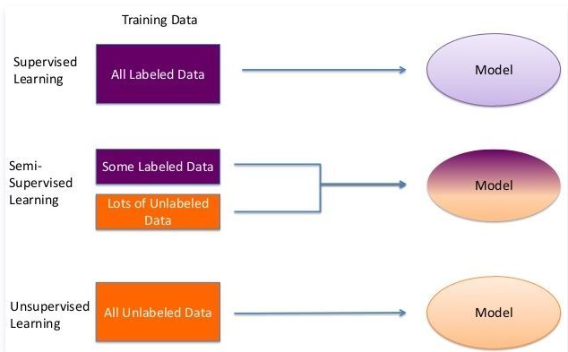
Semi-Supervised
完整的大量注释难以获得
充分利用数据信息
提高模型的性能
有标签数据和无标签数据具有相同的分布
模型性能下降

Slide 3
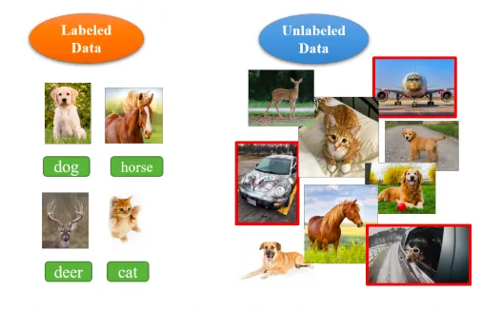
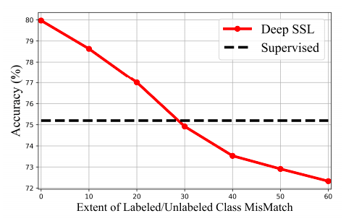

Semi-Supervised
乐观的假设：有标签的数据和无标签的数据来自相同的分布

Slide 4
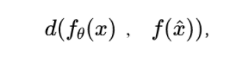
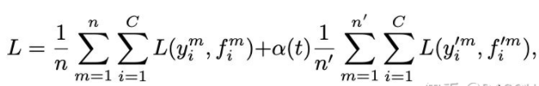
Semi-Supervised
Consistency Regularization:给定一个未标记的数据点及其扰动的形式 ，目标是最小化两个输出之间的距离。对于无标签图像，添加噪声之后模型预测也应该保持不变
Pseudo Label:先使用模型生成伪标签，然后与有标签的数据一起训练，提供额外的信息。
Match系列：将几种半监督方法进行混合

Slide 5
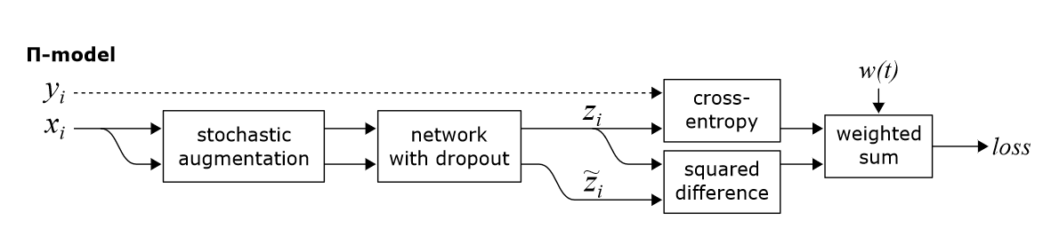
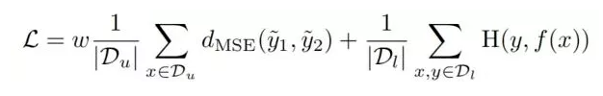
Image classification
ICLR2017 , Temporal Ensembling for Semi-Supervised Learning

Slide 6

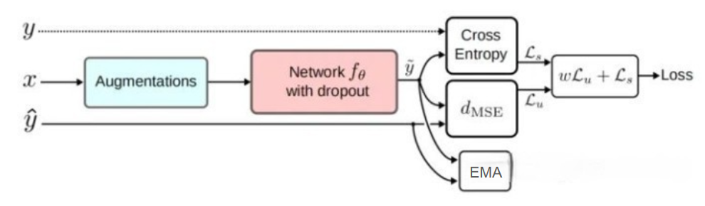
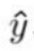
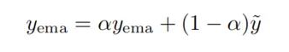
Image classification
用空间来换取时间，总的前向推理次数减少了一半，因而减少了训练时间
通过历史预测做平均，有利于平滑单次预测中的噪声
ICLR2017 , Temporal Ensembling for Semi-Supervised Learning

Slide 7
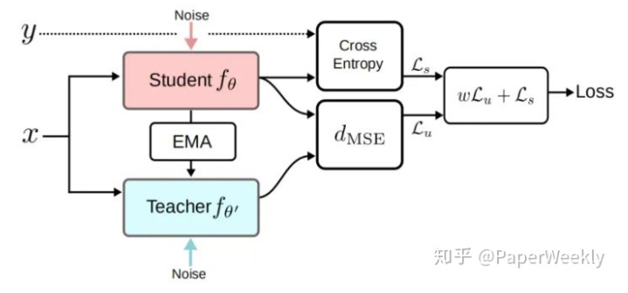
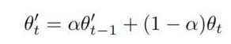
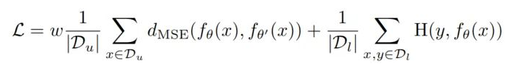
Image classification
NIPS 2017 , Mean teachers are better role models

Slide 8
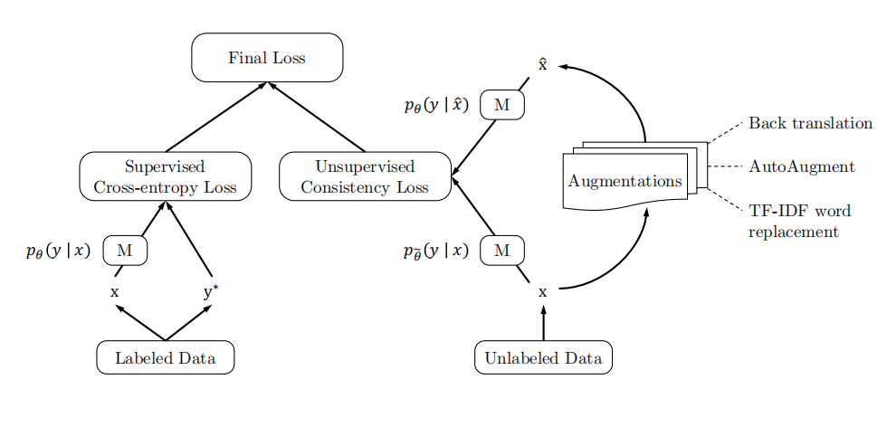
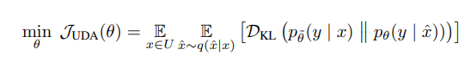
Image classification
NeurIPS 2020 , Unsupervised Data Augmentationfor Consistency Training

Slide 9
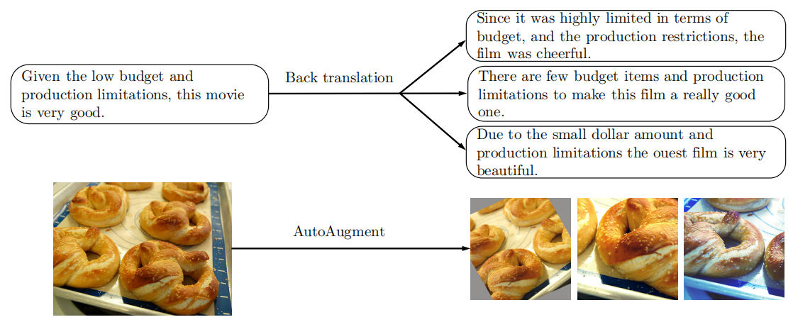
Data Augmentation
图像分类:AutoAugment,在所有的图像处理转换方式中进行搜索，以便找到一个最优的增强策略
文本分类:Back translation,把一个样本（语言A）转换成另一个语言B再转换回来
NeurIPS 2020 , Unsupervised Data Augmentationfor Consistency Training

Slide 10
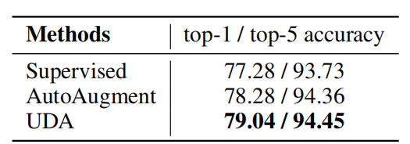
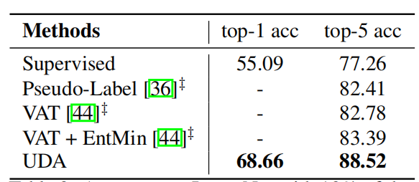
Results
NeurIPS 2020 , Unsupervised Data Augmentationfor Consistency Training

Slide 11
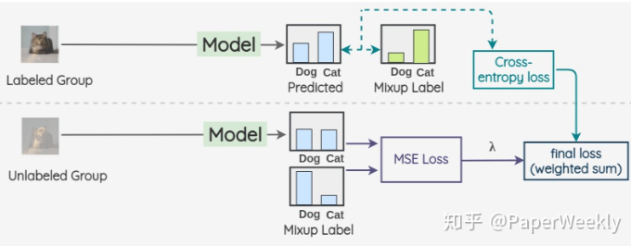
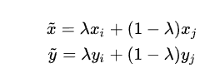
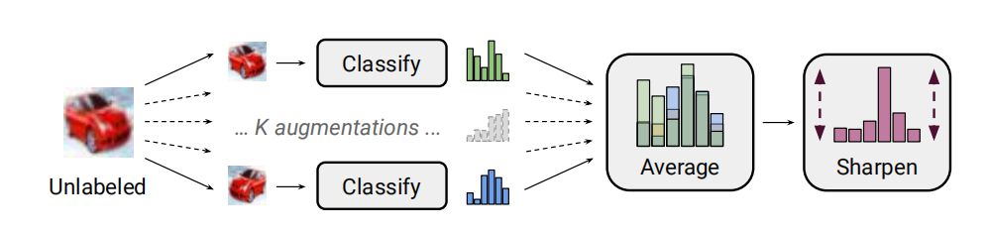
Image classification
NeurIPS 2019 , MixMatch: A Holistic Approach to Semi-Supervised Learning

Slide 12
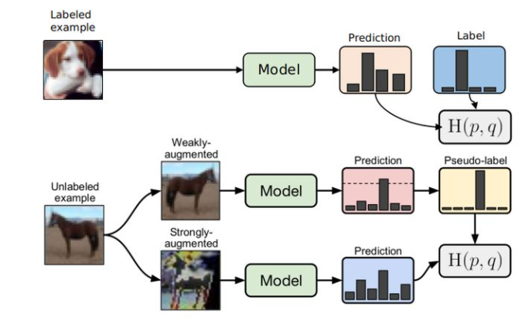
Image classification
NeurIPS 2020 , FixMatch: Simplifying Semi-Supervised Learning with Consistency and Confidence

Slide 13
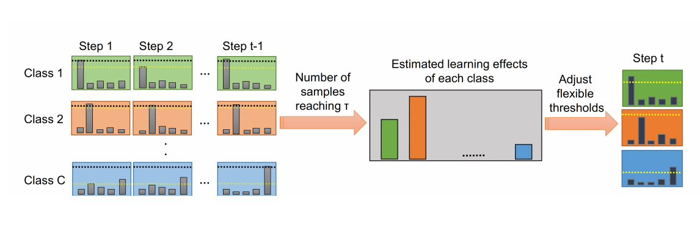
Image classification
NeurIPS 2021 , FlexMatch: Boosting Semi-Supervised Learning with Curriculum Pseudo Labeling

Slide 14
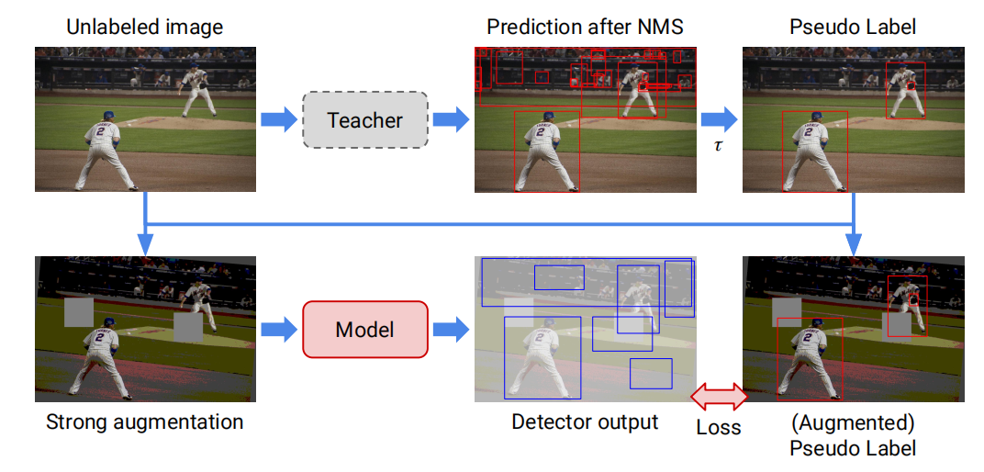
Object Detection
2020, A Simple Semi-Supervised Learning Framework for Object Detection

Slide 15
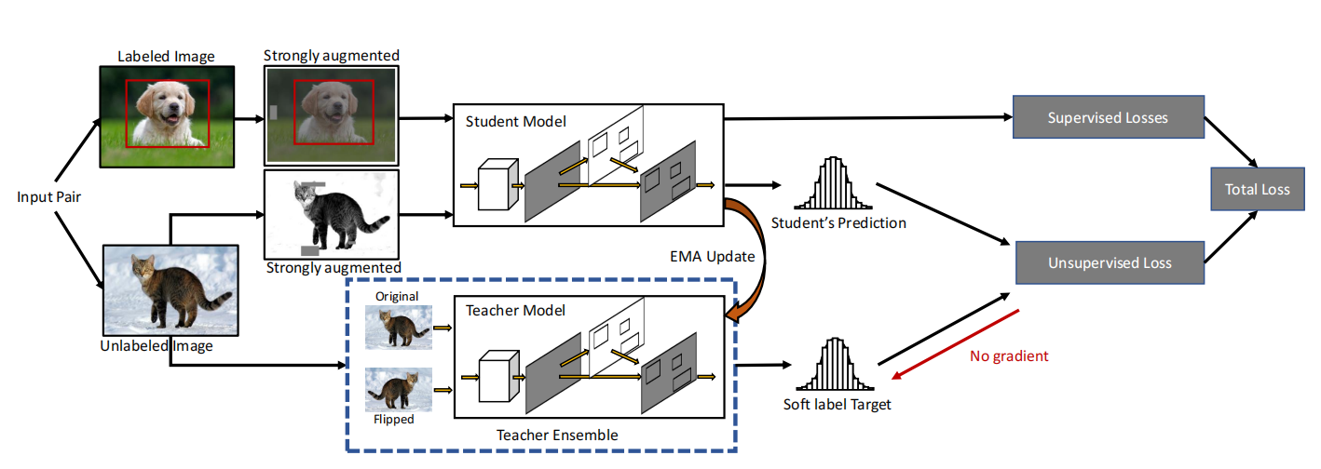
Object Detection
CVPR 2021, Humble Teachers Teach Better Students for Semi-Supervised Object Detection

Slide 16
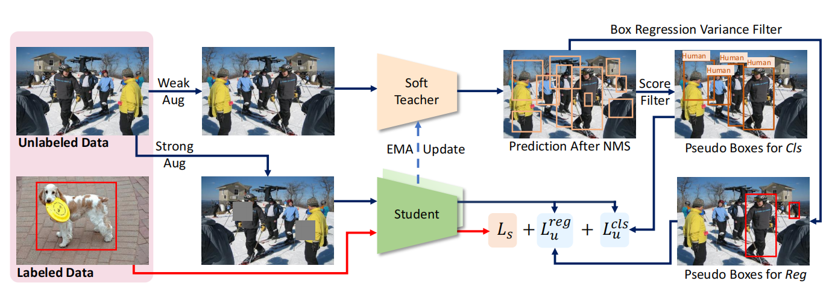
Object Detection
ICCV 2021, End-to-End Semi-Supervised Object Detection with Soft Teacher

Slide 17
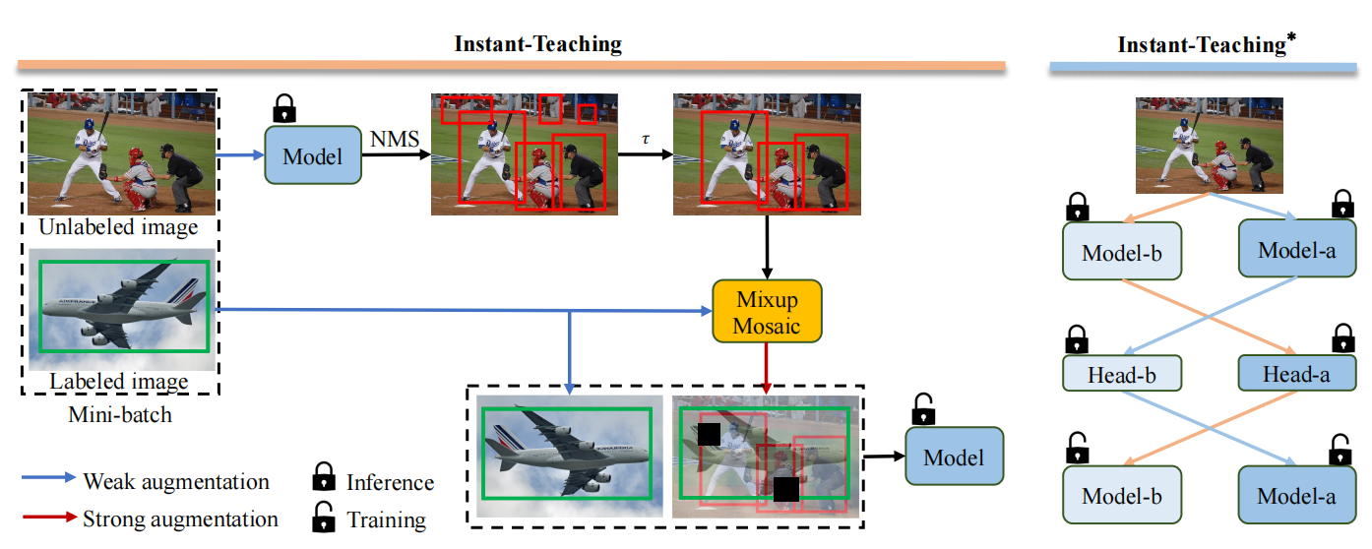
Object Detection
CVPR 2021, Instant-Teaching: An End-to-End Semi-Supervised Object Detection Framework

Slide 18
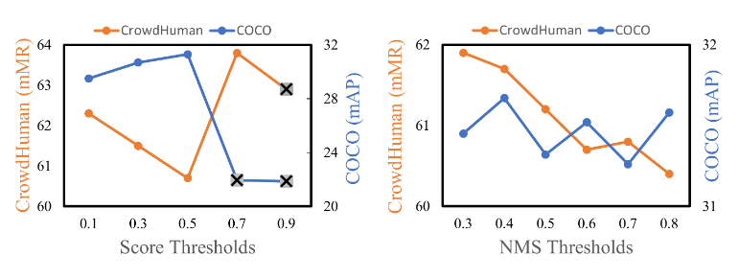
Object Detection
模型的效果随着 threshold 的波动而剧烈波动
对未标记数据应用检测框回归损失将导致不稳定的训练
ECCV 2022, Dense Teacher: Dense Pseudo-Labels for Semi-supervised Object Detection

Slide 19
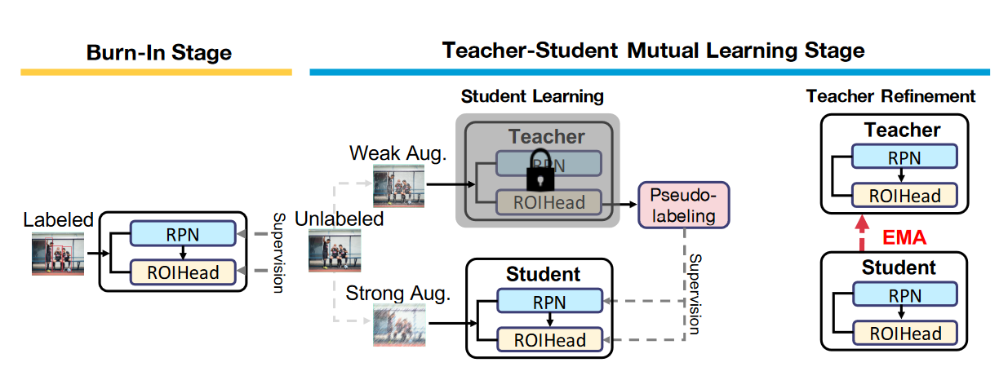
Object Detection
ICLR 2021, Unbiased Teacher for Semi-Supervised Object Detection

Slide 20
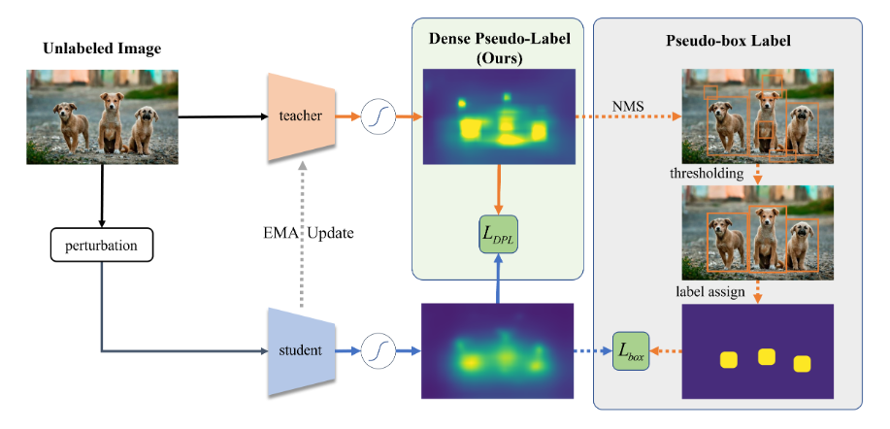
Object Detection
ECCV 2022, Dense Teacher: Dense Pseudo-Labels for Semi-supervised Object Detection

Slide 21
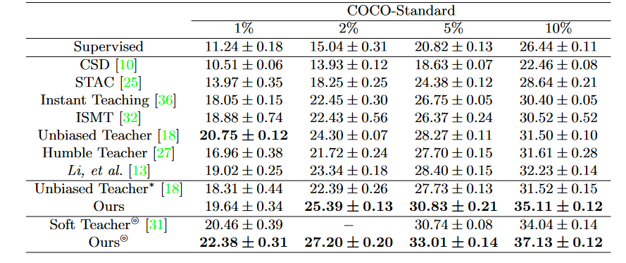
Results
ECCV 2022, Dense Teacher: Dense Pseudo-Labels for Semi-supervised Object Detection

Slide 22
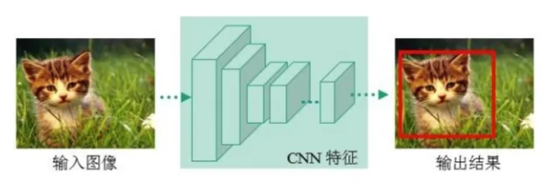
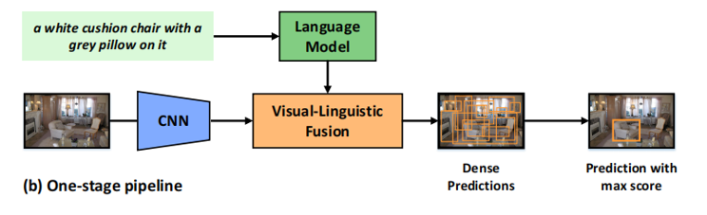
Pipeline
目标检测pipeline
Visual Grounding pipeline

Slide 23
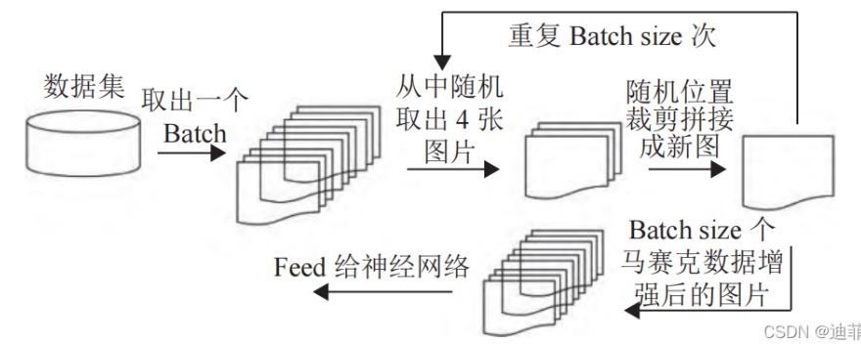
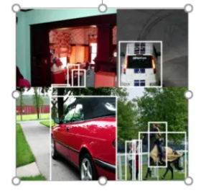
Data Augmentation

Slide 24
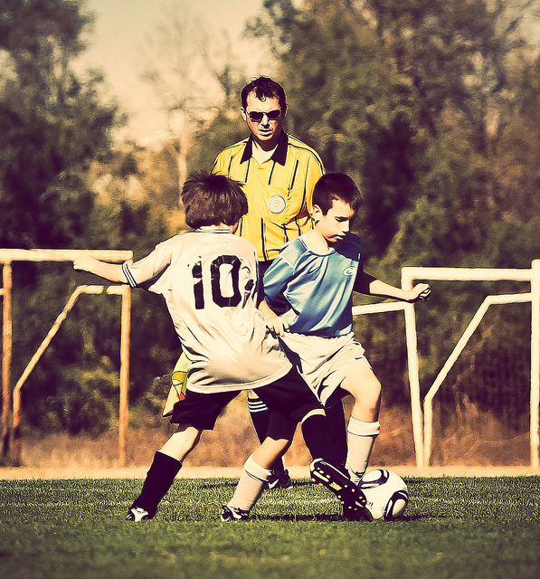
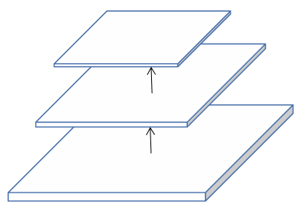
Pseudo Annotation
#3
#1: player on the right
#2: num 10
#1
#2
Unlabeled Image
#3: missing query
#4
#4: missing query
Object Detector

Slide 25
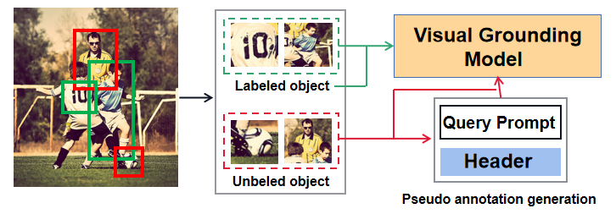
Query Generation
(a) 通过简易模型生成查询 (b) 使用预训练模型辅助生成查询 (c) 直接传入检测框特征

